Slide 1
What is Data Science?
Arun Kumar

Slide 2
What is Machine Learning?
Machine Learning is the science (and art) of programming computers so they can learn from data.
A computer program is said to learn from experience E with respect to some task T and some performance measure P, if its performance on T, as measured by P, improves with experience E.
Arun Kumar

Slide 3
Major categories of Machine Learning
supervised learning
unsupervised learning
semisupervised learning
Reinforcement Learning
Arun Kumar

Slide 4
Supervised learning
In supervised learning, the training data you feed to the algorithm includes the desired solutions, called labels.
Eg. Classification-> spam or ham email example,cancer detection
Eg. Regression-Prediction of price of a car
given a set of features(mileage, age, brand, etc.) called predictors
labels(i.e., their prices).
Arun Kumar

Slide 5
Some important supervised learning algorithms
k-Nearest Neighbors
Linear Regression
Logistic Regression
Support Vector Machines (SVMs)
Decision Trees and Random Forests
Neural networks
Arun Kumar

Slide 6
Unsupervised learning
In unsupervised learning,the training data is unlabeled.The system tries to learn itself.
unsupervised task->anomaly detection->detecting unusual creditcard transactions to prevent fraud, catching manufacturing defects
unsupervised task->association rule learning
Clustering
k-Means
Hierarchical Cluster Analysis (HCA)
Expectation Maximization
Arun Kumar

Slide 7
Visualization and dimensionality reduction
Principal Component Analysis (PCA)
Kernel PCA
Locally-Linear Embedding (LLE)
t-distributed Stochastic Neighbor Embedding (t-SNE)
Arun Kumar

Slide 8
Association rule learning
Apriori
Eclat
Arun Kumar

Slide 9
Semisupervised learning
Most semisupervised learning algorithms are combinations of unsupervised and supervised algorithms.
Eg:- Google photos
Arun Kumar

Slide 10
Reinforcement Learning
The learning system, called an agent in this context,can observe the environment, select and perform actions, and get rewards in return (or penalties in the form of negative rewards. It must then learn by itself what is the best strategy, called a policy, to get the most reward over time. A policy defines what action the agent should choose when it is in a given situation.
Eg-Self driving car,Robotics
Arun Kumar

Slide 11
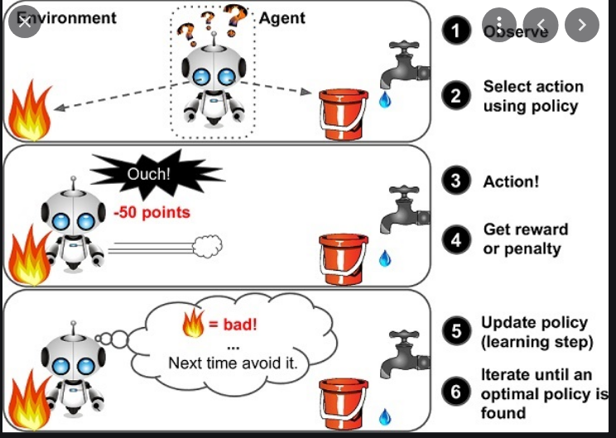
Arun Kumar

